Slide 1
Supermarket data Analysis
Presented to:
Prof. Usama Sharaf
Prof. Danish asim

Slide 2
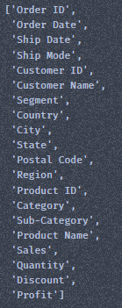
Impacts of the data
Columns on which Analysis can be Performed
3 Ship Mode
Total Columns: 20
11 Columns
793 Customers
Total Records: 9,994
3 Segments
531 Cities
49 States
37,873 Units Sold
4 Regions
Total Sales: 2,997,200 $
1850 Products
Total Profit: 286,397 $
3 Categories
17 Sub-Categories

Slide 3
Business Analysis
Most Profitable Cities
New York City
Los Angeles
Seattle
San Francisco
Detroit
Cities with lowest Profits that need
Marketing, Attention and Support
Chicago
Lancaster
San Antonio
Houston
Philadelphia

Slide 4
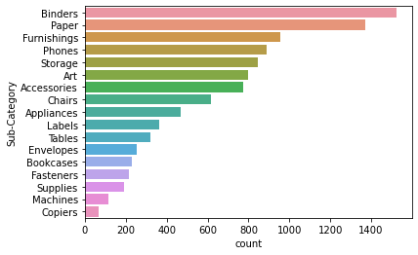
Sub-Categories with most quantity sold

Slide 5
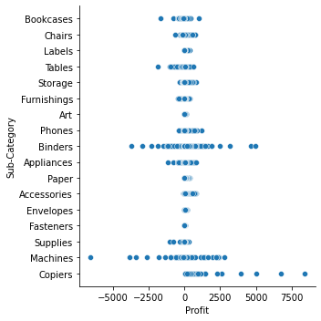
Sub-Category wise profit

Slide 6
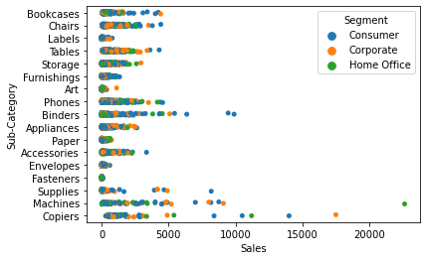
Sub-category wise sales according to segments

Slide 7
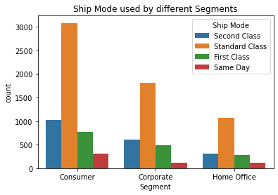
Ship mode used by different segments

Slide 8
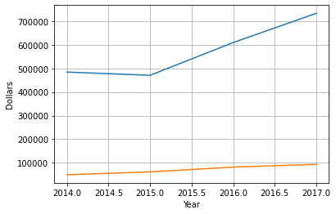
Year wise profit and sales

Slide 9
Product analysis
Most Profitable Products
Canon Advanced Copier
Fellows Plastic Comb Binding Machine
Hewlett Packard LaserJet 3310 Copier
Canon Personal Laser Copier
HP Design jet T520 Inkjet
Cities with lowest Profits that need
Marketing, Attention and Support
Cubify CubeX 3D Printer
Lexmark Laser Printer
Chromcraft Wood Tables
Bush Advantage Table

Slide 10

Units sold each year

Slide 11
THANK YOU

